Slide 1
EVENT MANAGEMENT FOR DEVELOPERS

Slide 2
A Program for an Event
XYZ is a company based in Toronto for even management, currently it works on a project to manage an event for 30 days for a group of developers from all over US.
The Company has put a good program including stay arrangements, discussion rooms, landscape visit places, cafes and restaurants.

Slide 3
Data Description
XYZ uses the data provided by Foursquare location data. The data are grouped by landscape area, and each area includes information about restaurants, hotels and cafes in this area.

Slide 4
Data Acquistion
GETTING DATA FROM FOURSQUARE API,
DATA ABOUT NEARBY HOTELS IS USED TO PLAN THE STAY
DATA ABOUT NEARBY CAFES IS USED TO PLAN THE DINING
DATA ABOUT NEARBY HALLS IS USED TO PLAN THE MEETUP

Slide 5
Data pre-processing
DATA IS PREPROCESSED I.E NULL VALUES ARE REMOVED AND DATA IS NORMALIZED FOR BETTER RESULTS
UNKNOWN VALUES ARE ELIMINATED FROM THE DATA

Slide 6
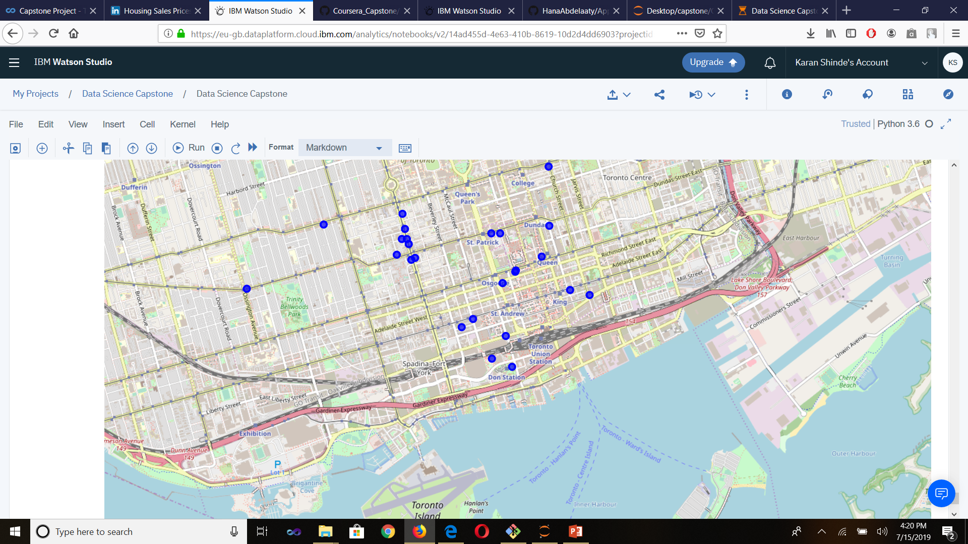
Cluster generated

Slide 7
Result
I HAVE GENERATED CLUSTER FOR DATA I.E NEARBY LOCATIONS FROM THE CURRENT LOCATIONS

